Slide 1
CISC 250 COOP - I

Slide 2
Express 145.32.59.24 in binary format and identify the classful prefix length.
 | 2^7=128 | 2^6=64 | 2^5=32 | 2^4=16 | 2^3=8 | 2^2=4 | 2^1=2 | 2^0=1
145 | 1 | 0 | 0 | 1 | 0 | 0 | 0 | 1
32 | 0 | 0 | 1 | 0 | 0 | 0 | 0 | 0
59 | 0 | 0 | 1 | 1 | 1 | 0 | 1 | 1
24 | 0 | 0 | 0 | 1 | 1 | 0 | 0 | 0
1 0010001.00100000.00111011.00011000 /16 or Class B

Slide 3
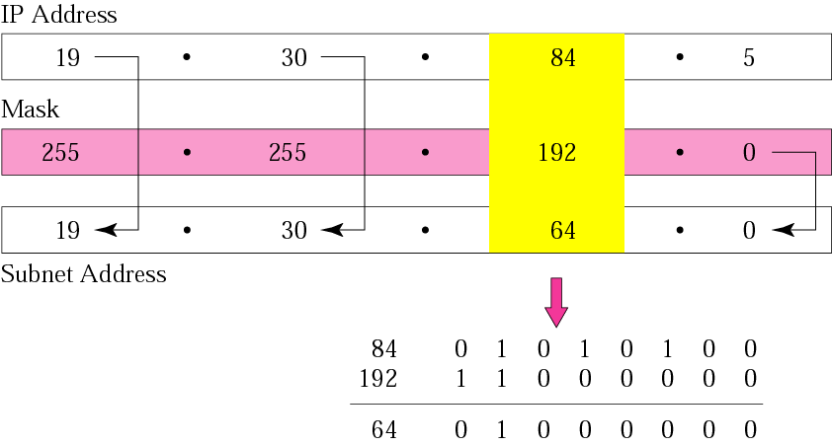
What is the subnet address if the destination address is 19.30.84.5 and the mask is 255.255.192.0?

Slide 4
Assume that you have been assigned the 132.45.0.0/16 network block. You need to establish 8 subnets.
Three binary digits are required to define the eight subnets.
2. Specify the extended-network-prefix that allows the creation of 8 subnets.
/19 or 255.255.224.0
3. Express the subnets in binary format and dotted decimal notation:
Subnet #0: 10000100.00101101. 000 00000.00000000 = 132.45.0.0/19
Subnet #1: 10000100.00101101. 001 00000.00000000 = 132.45.32.0/19
Subnet #2: 10000100.00101101. 010 00000.00000000 = 132.45.64.0/19
Subnet #3: 10000100.00101101. 011 00000.00000000 = 132.45.96.0/19
Subnet #4: 10000100.00101101. 100 00000.00000000 = 132.45.128.0/19
Subnet #5: 10000100.00101101. 101 00000.00000000 = 132.45.160.0/19
Subnet #6: 10000100.00101101. 110 00000.00000000 = 132.45.192.0/19
Subnet #7: 10000100.00101101. 111 00000.00000000 = 132.45.224.0/19

Slide 5
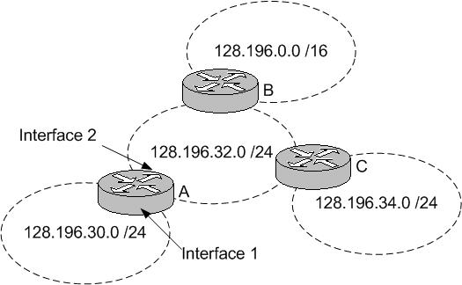
For the networks shown below, list the routing table for router A (Hint: list all networks that are directly or indirectly connected to A; use the number of hops between routers as your metric; assume router B is the default router). When a packet arrives at the router A for the destination address 128.196.34.2, what will the router A do with this packet?
For this incoming packet, router A first takes the destination IP address 128.196.34.2, masks it with the subnet mask in each row in the routing table, and then compares the result with the Network/Subnet value in that row. If the result matches, it adds the row to the list of matching rows for that packet. In this example, there are two matches: the subnets 128.196.0.0 and 128.196.34.0. The row of 128.196.34.0 is selected as the best match because it is the longest match. Finally, the packet is sent out through the interface 2 to the Next-hop-router (router C) listed in this best matching row (or to the Destination host if next-hop router value in best row says “local”).
Row | Network/Subnet | Mask (/Prefix) | Metric | Interface | Next-Hop Router
1 | 0.0.0.0 | 0.0.0.0 /0 | 1 | 2 | B
2 | 128.196.30.0 | 255.255.255.0 /24 | 0 | 1 | Local
3 | 128.196.32.0 | 255.255.255.0 /24 | 0 | 2 | Local
4 | 128.196.0.0 | 255.255.0.0 /16 | 1 | 2 | B
5 | 128.196.34.0 | 255.255.255.0 /24 | 1 | 2 | C

Slide 6
If you wanted to have 12 subnets with a Class C network ID, what subnet mask would you use?
For a Class C network ID, you have 8 bits for the host part. To have 12 subnets, you need to use at least 4 bits (2⁴=16) for your subnet part. Therefore, the subnet mask will be
11111111.11111111.11111111.11110000
255.255.255.240

